Slide 1
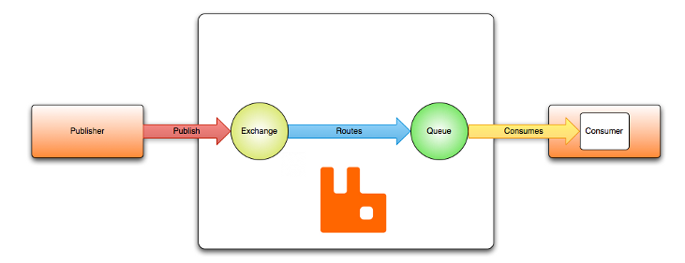
AMQP 0-9-1 Model - Default Exchange
The default exchange is a direct exchange with no name (empty string) pre-declared by the broker. It has one special property that makes it very useful for simple applications: every queue that is created is automatically bound to it with a routing key which is the same as the queue name.
For example, when you declare a queue with the name of "search-indexing-online", the AMQP 0-9-1 broker will bind it to the default exchange using "search-indexing-online" as the routing key. Therefore, a message published to the default exchange with the routing key "search-indexing-online" will be routed to the queue "search-indexing-online". In other words, the default exchange makes it seem like it is possible to deliver messages directly to queues, even though that is not technically what is happening.

